Slide 1
Predicting Loneliness in College Students During a Pandemic
Olivia Nichols, Luyang Jia, Said Alhassan, Jessica Barta, Allene Xing

Slide 2
Recap
We think that rates of student physical activity will predict their perceived loneliness and the priming word “COVID-19” will have a negative effect on the perceived mental health (loneliness).
Primary Predictors: Exercise, physical activity, priming
Other Predictors: Living on Campus or not, Living alone or not
Outcome: Perceived loneliness, perceived mental health

Slide 3
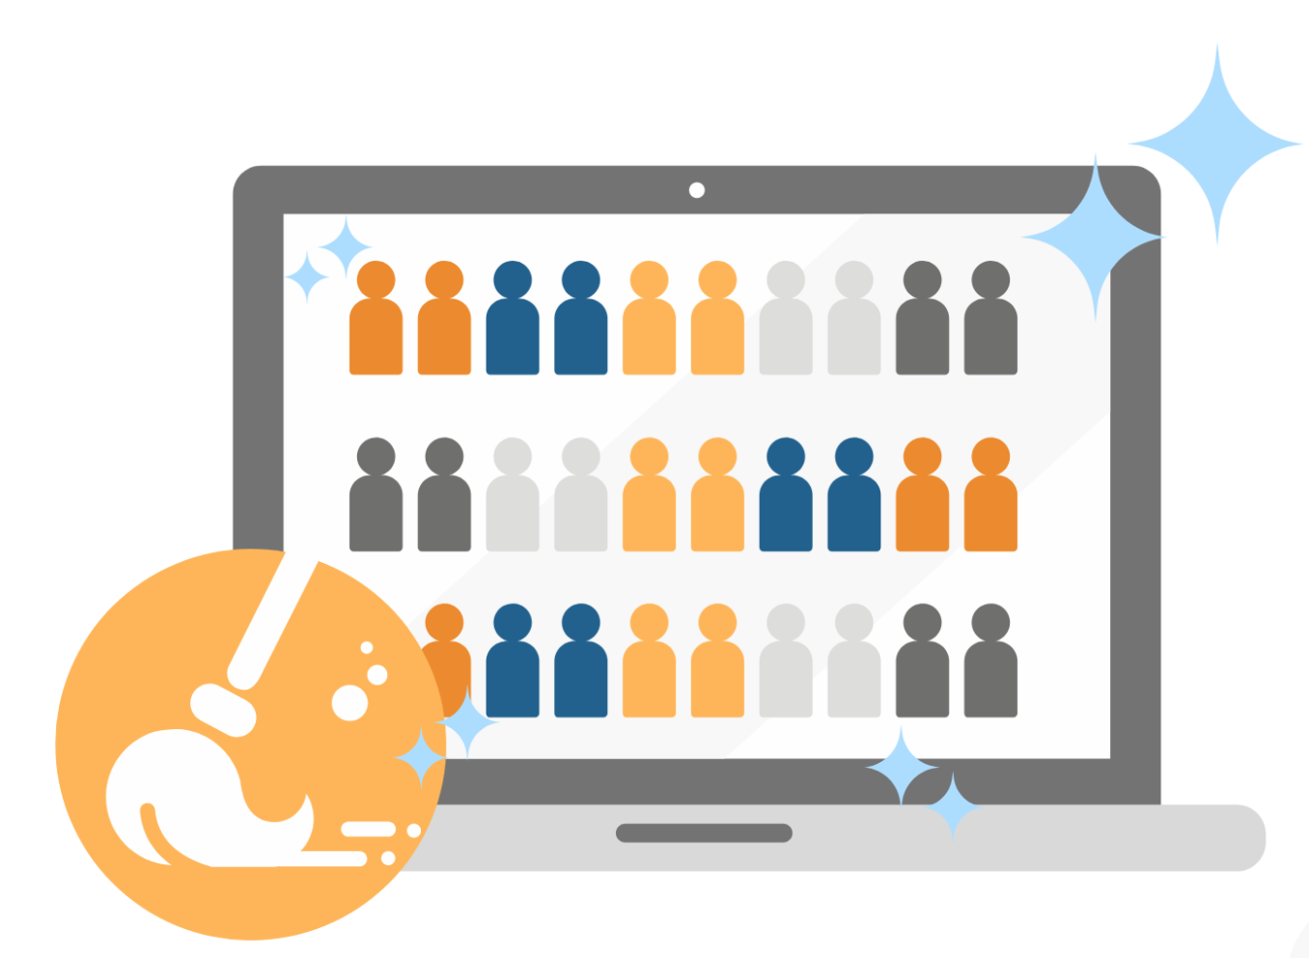
Data Cleaning
Responses: 95 collected (65 are complete and valid)
Tasks
1) Score physical activity and perceived loneliness
2) Filter out outliers in physical activity
3) Identify and drop responses that fail the attention check in the loneliness scale

Slide 4
Data Cleaning
Convert variables into a single index for Physical Activity
6 Variables: frequency (days/week) and the duration (minutes/day) of vigorous activity, moderate activity, and walking
MET: average multiples of the resting metabolic rate (weight for each activity)
Walking MET-minutes/week = 3.3 * walking minutes * walking days
Moderate MET-minutes/week = 4.0 * moderate-intensity activity minutes * moderate days
Vigorous MET-minutes/week = 8.0 * vigorous-intensity activity minutes * vigorous days
Physical Activity-minutes/week = Walking MET-minutes/week + Moderate MET-minutes/week + Vigorous MET-minutes/week

Slide 5
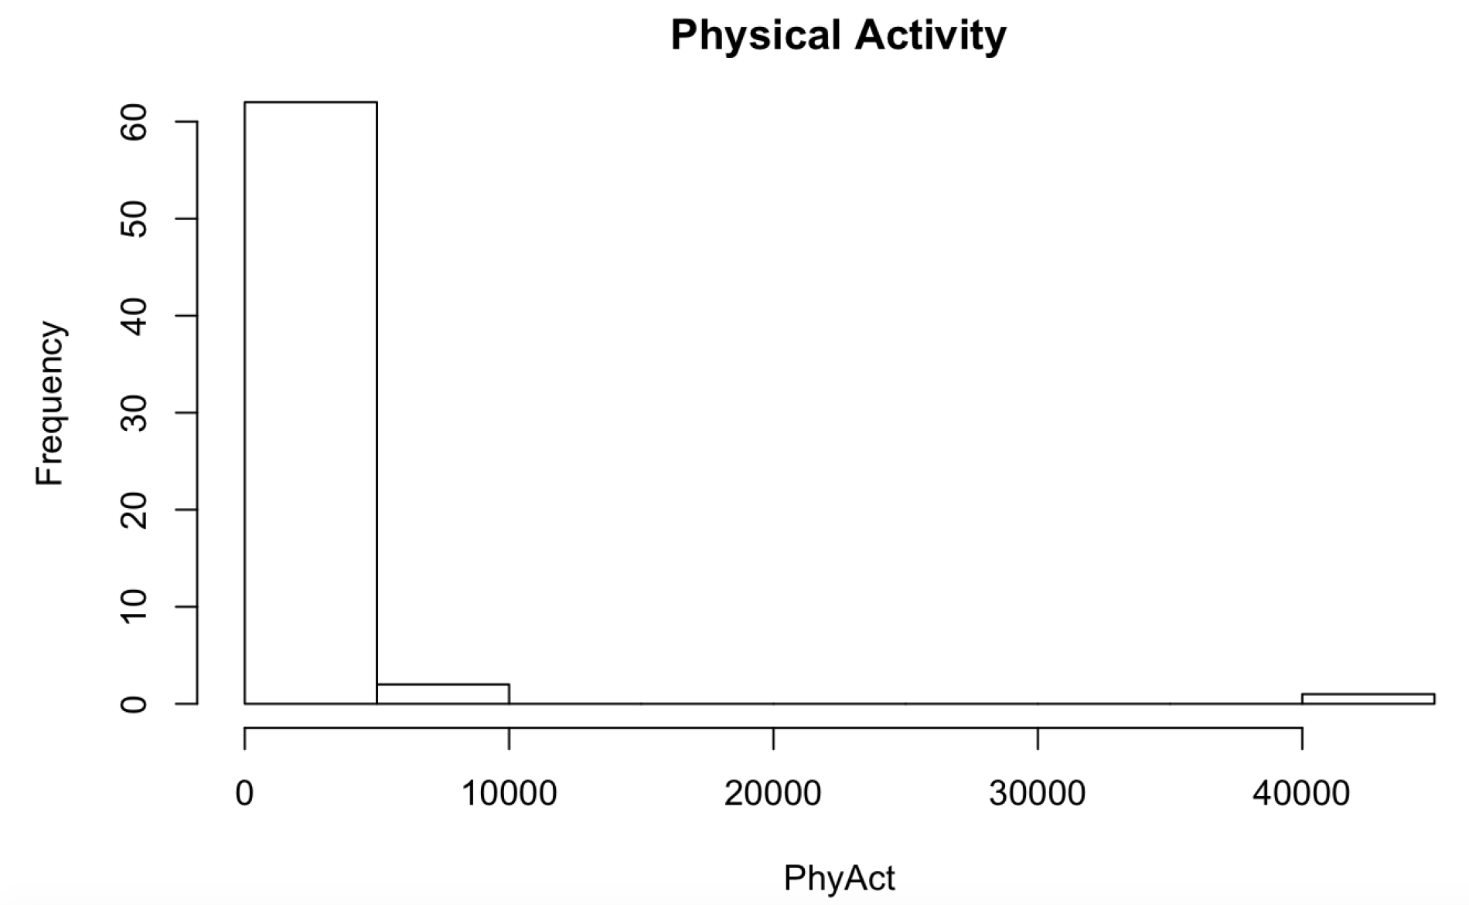
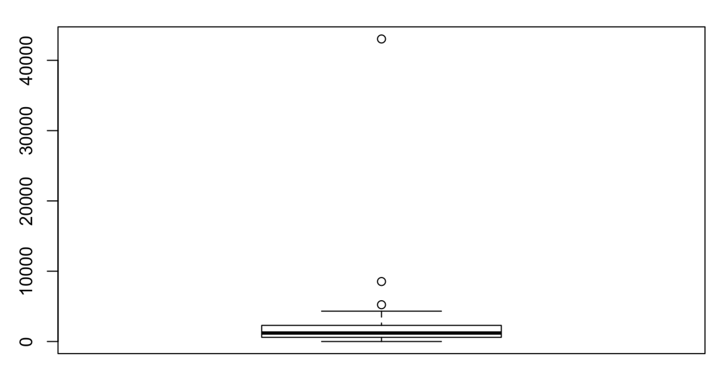
Data Cleaning
Physical Activity-minutes/week: outliers
Physical Activity
PhyAct

Slide 6
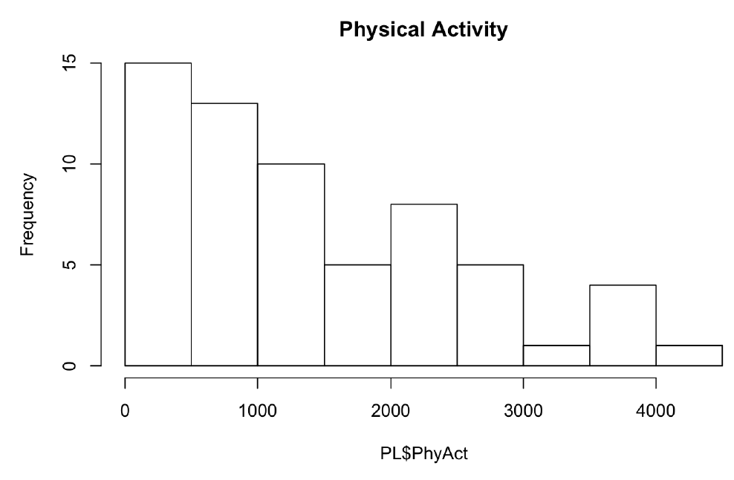
Data Cleaning
Physical Activity-minutes/week: after dropping outliers

Slide 7
Data Cleaning
Loneliness Scale: 20 questions:
“ I am unhappy doing so many things alone” , 1=Often, 2=Sometimes, 3=Rarely, 4=Never
A lower score represents higher perceived loneliness
Attention Check question:
“I have enough support from my family/friends”, 1=Often, 2=Sometimes, 3=Rarely, 4=Never
A higher score represents higher perceived loneliness
Reverse coding for Loneliness Scale and take the average: Perceived Loneliness
Ideally, the score of Attention Check is positively correlated with Perceived Loneliness

Slide 8
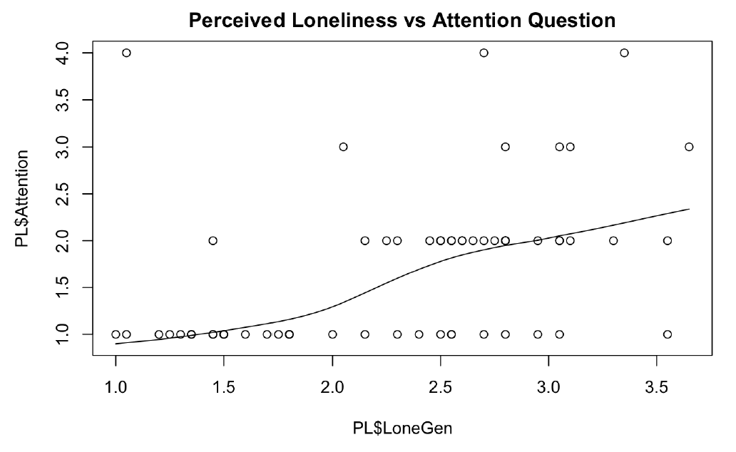
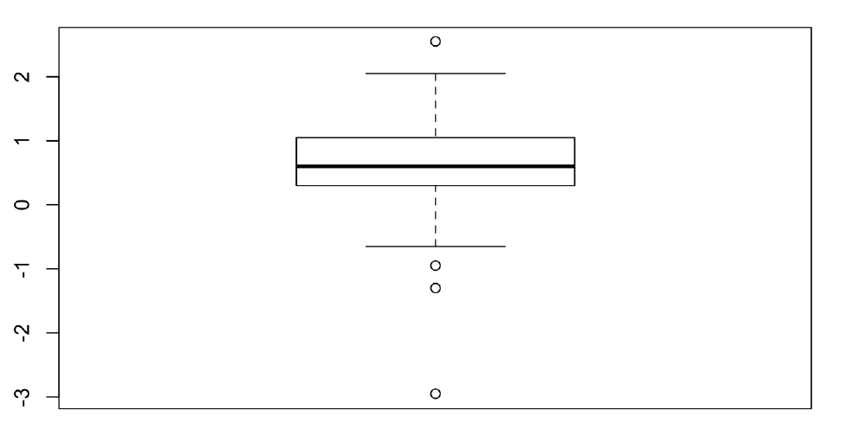
Data Cleaning
Perceived Loneliness vs Attention Question
Perceived Loneliness - Attention Question

Slide 9
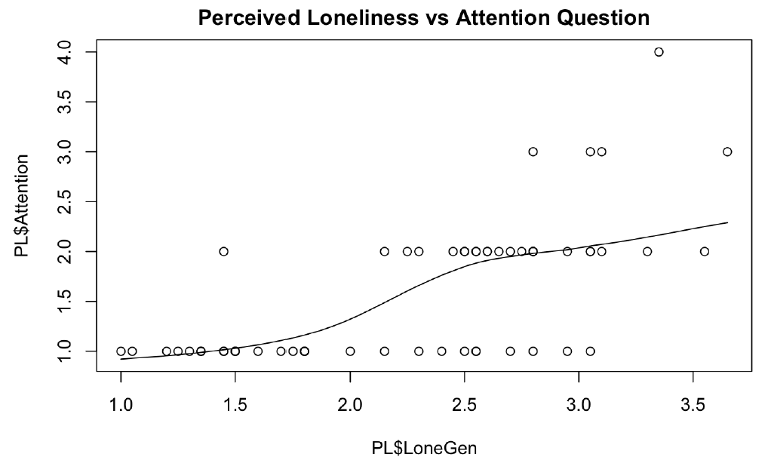
Data Cleaning
Perceived Loneliness vs Attention Question: after dropping responses that failed the Attention Check

Slide 10

Data Cleaning
Responses: 95 collected (65 are complete and valid)
Tasks
1) Score physical activity and perceived loneliness ✅
2) filter out outliers in physical activity ✅
3) Identify and drop responses that fail the attention check in the loneliness scale ✅
7 responses were dropped and 58 responses were used in data analysis.

Slide 11
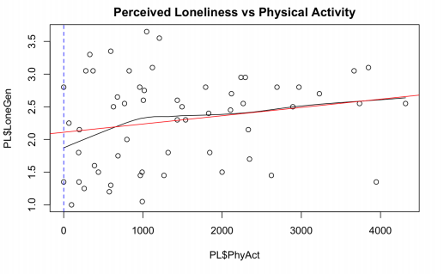
Physical Activity and Loneliness
Direct relationship between physical activity and loneliness…
Positive association?
Let’s look at some interaction effects....

Slide 12
Priming
Random assignment of participants to survey groups, all questions and wording were the same except for prompts before the loneliness scale section
Group 1 prompt: “We’re interested in learning more about the mental health of college students during the Covid-19 pandemic.”
Group 2 prompt: “We’re interested in learning more about the mental health of college students.”

Slide 13
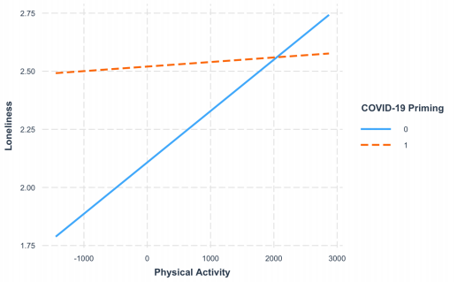
Priming
How does changing the wording of the survey affect perceived loneliness?
How can we compare the effects of priming with physical activity?
Notable difference between primed group and non-primed group
R^2=.1569, F(3, 54)=3.35, p>.03, Adj R^2=.1101

Slide 14
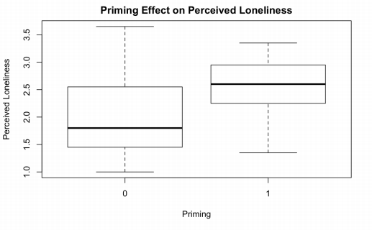
Priming
On average, those who were primed with “Covid-19 pandemic” had higher scores for loneliness than those who were not

Slide 15

Conclusions: Priming
Wording matters!
Students feel that the pandemic has had a negative impact on their mental health
Possible explanations:
Negative association with words “Covid-19” and “pandemic” in the media
Life events associated with “Covid-19” vs. those not associated

Slide 16
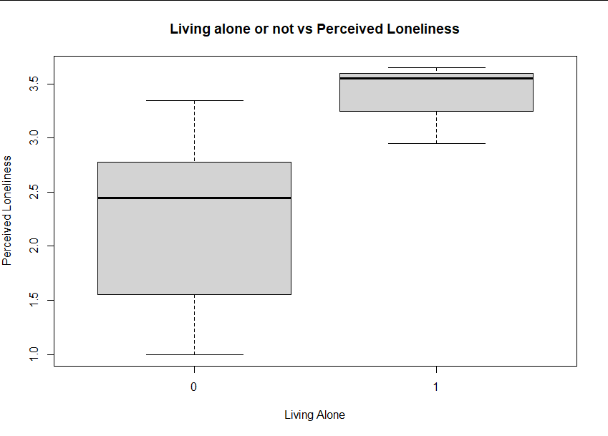
Isolation
Group 0: Living not alone.
Group 1: Living alone.
Clearly living alone has a negative effect on one’s mental health by increasing perceived loneliness.

Slide 17
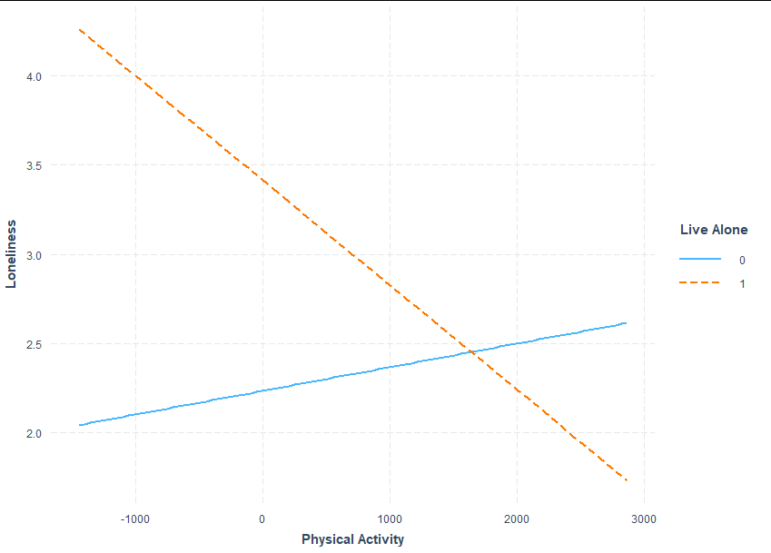
Isolation
Group 0: Living not alone.
Group 1: Living alone.
Interestingly, if you live alone, the more you work out the more lonely you feel!
Thoughts?
Theory coming soon…
R^2=.1916, F(3, 54)=4.265, p=.009, Adj R^2=.1467

Slide 18
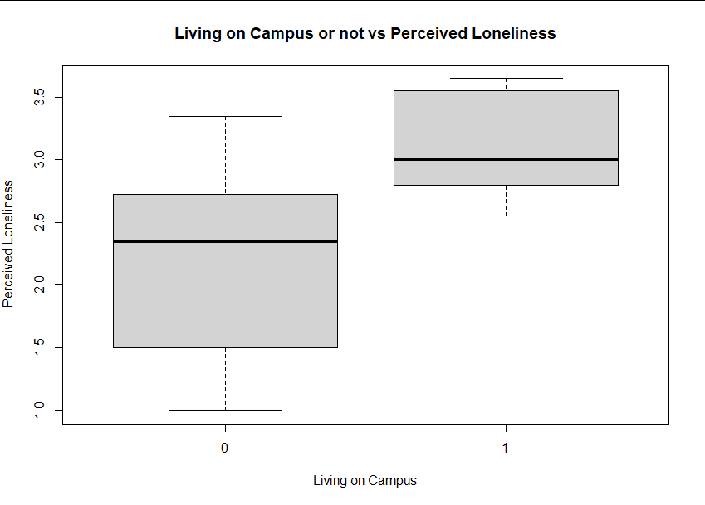
Isolation
Group 0: Living not on campus.
Group 1: Living on campus.
Living on campus can make people feel more lonely.

Slide 19

Isolation-Living on Campus
Living on campus predicts increased loneliness, unlike exercise
-lower perceived social support
-living alone (somewhat)

Slide 20
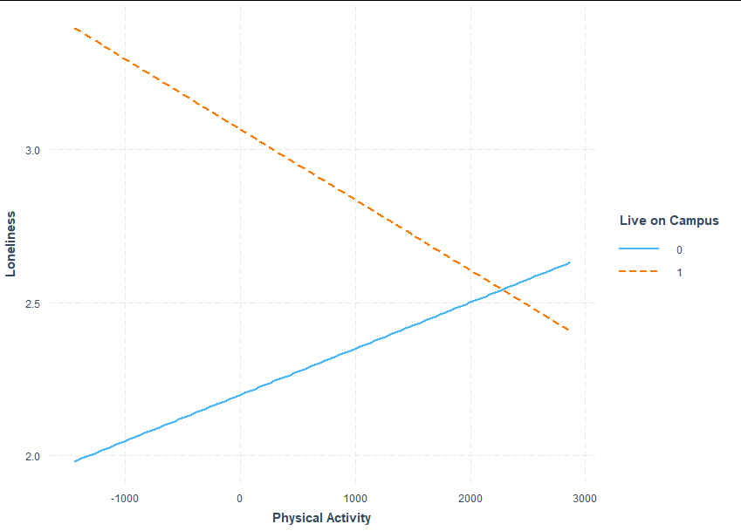
Isolation
Group 0: Living not on campus.
Group 1: Living on campus.
Again if you live “by yourself” (or on campus) the more you work out the more lonely you feel…
But why?
R^2=.2171, F(3, 54)=4.99, p=.004, Adj R^2=.1736

Slide 21
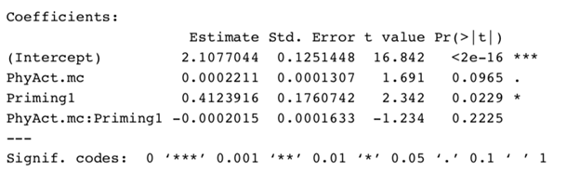
Results
Overall, results supported our hypotheses that the presence of priming and living alone would significantly predict increased loneliness. At the same time, our other hypotheses that living on campus and exercising would significantly predict decreased loneliness, were not supported.

Slide 22
In Conclusion...
Main theory for why:
You don’t get to see friends as often due to COVID...
You can’t work out without socially distancing…
You can’t see people with impaired immune systems or elderly people such as friends or family...
Worst of all, you have to take online classes…
Some possibilities:
Perhaps due to social distancing and other COVID restrictions people exercise alone or don’t see their friends and family and that then enhances lonely thoughts since they aren’t around their usual work out friends or partners?
Or our model just didn’t capture another very important variable.
Confounding variables, other interaction effects...

